Slide 1
Quick intro to OOP (Object Oriented Programming)

Slide 2
What is OOP?
Def: Object-oriented programming (OOP) refers to a type of computer programming(software design) in which programmers define not only the data type of a data structure, but also the types of operations (functions) that can be applied to the data structure.
In other words, you can make an abstraction of a real life object in a program.
E.g. You can make a ‘Sheep’ object which can walk, eat etc

Slide 3
Why use OOP?
OOP provides a clear modular structure for programs which makes it good for defining abstract datatypes where implementation details are hidden and the unit has a clearly defined interface.
OOP makes it easy to maintain and modify existing code as new objects can be created with small differences to existing ones.
OOP provides a good framework for code libraries where supplied software components can be easily adapted and modified by the programmer.

Slide 4
Classes
What are they?
In object-oriented programming, a class is an extensible program-code-template for creating objects, providing initial values for state (member variables) and implementations of behaviour (member functions or methods).
How to make them?
Use the class keyword and give your class a name!
What are Constructors?
A special kind of method (aka function but applied to classes) that calls automatically when an object is instantiated. This essentially initializes all the attributes (aka the variables specific to this object).

Slide 5
Methods and attributes
What are they?
Methods: Functions specific to an object
Attributes: Variables specific to an object
How to make methods and attributes in python
Initialise variables in the constructor using the self keyword (example given in the following slide)
Just define functions as you would normally.
Don’t forget to indent it within the class

Slide 6
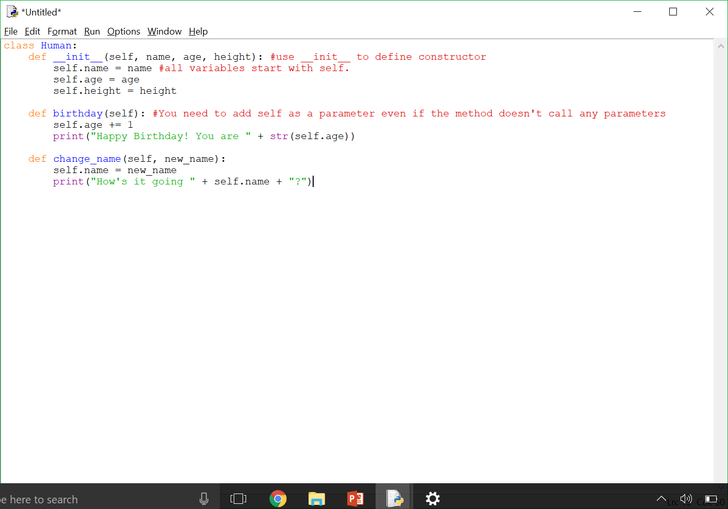
Define a class using the class keyword + said class’ name
You’re initialising the variables to use in the class
To call this object’s ‘name’ variable, you have to put self. in front of it

Slide 7
Further topics (advanced and to be done in own time)
Polymorphism (how to manipulate a class as per it’s data type)
Inheritance (Getting methods and attributes from a super class)
Private and Public attributes & methods (which methods and attributes should be available to a programmer)
Encapsulation (A language mechanism for restricting access to some of the objects components)
For more info:
http://www.python-course.eu/object_oriented_programming.php

